Slide 1

Manchester Raspberry Jam 29
May 2015

Slide 2

Last Time

Slide 3
Last Time
bit.ly/StormTheFeedback

Slide 4
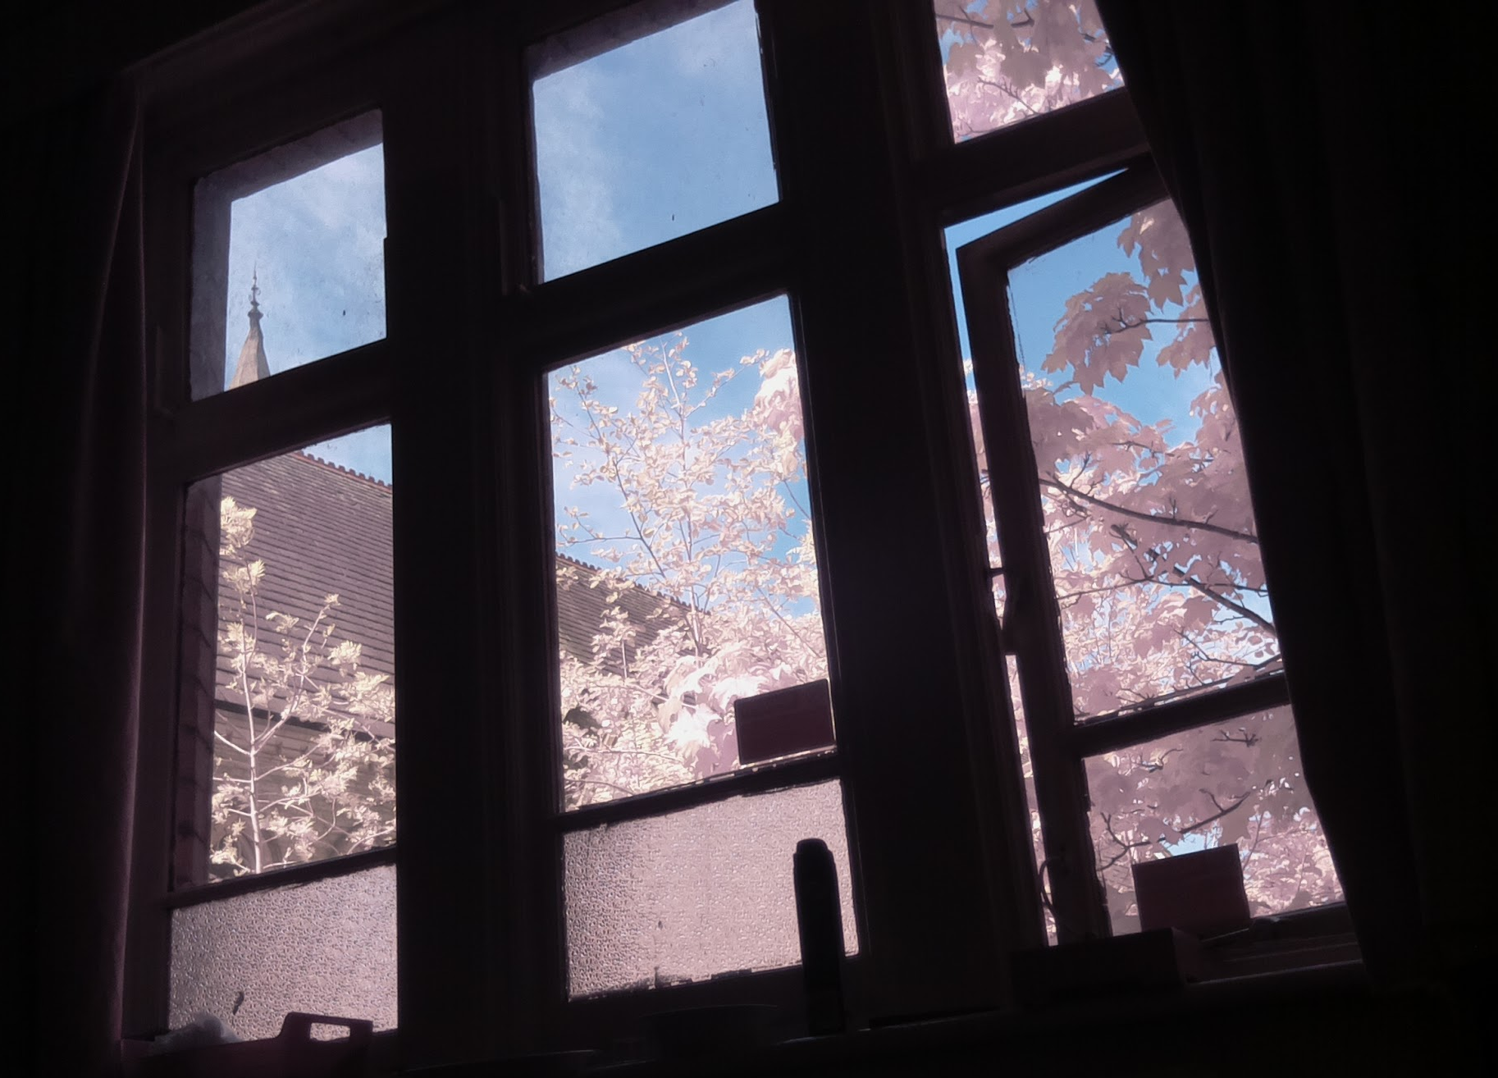
Todays workshop:

Slide 5
Today:
11:00 - Pi Camera workshop
13:00 - Lunch
14:00 - Pi Camera workshop again
WiFi:
SSID MMU-Visitor
Pass. University
Next Month’s Jam:
Saturday 16th May
Feedback for workshop: bit.ly/StormTheFeedback
Slides and other downloads at: bit.ly/McrRaspJam

